Slide 1
Ensuring the Educational Stability of Students in Foster Care
July 2025

Slide 2
Note to District Federal Program Manager and Foster Care Point of Contract:
You may use these slides to train yourself or to train your staff, such as principals, registrars, school administrative assistants, transportation staff, nutrition staff. All play a key role in ensuring students in foster care are provided their special rights given to them by ESEA.
These slides will not be very useful in training staff, however, unless you find all the red slides and fill in the specific protocols and procedures that your district uses regarding students in foster care.
If your district works with one of the four Title IV-E Tribal Foster Care Agencies [Aleut Community of St. Paul Island (Pribilofs), Kenaitze Indian Tribe (Kenai), Maniilaq Association (Kotzebue), or Central Council of Tlingit and Haida Indian Tribes of Alaska (Juneau and Southeast)], please add information about your partnership with them to each slide where it asks for information about your partnership with OCS.

Slide 3
ESEA and Children in Foster Care
ESEA requires districts accepting ESEA funds to help ensure the educational stability of students in foster care
ESEA Sections:
1111(g)(1)(E)
1112(c)(5)
1111(h)

Slide 4




Main Goal of Title I-A Foster Care Requirements
Keep students taken into foster care in the same school they were previously attending, regardless of changes in foster care placement.

Slide 5
Definition of Foster Care Used by ESEA
24-hour substitute care for children placed away from their parents or guardians and for whom the Title IV-E agency has placement and care responsibility.
In Alaska, at this time, the only SSA Title IV-E Agencies (under US HHS) are:
  Office of Children’s Services (OCS)
  The Aleut Community of St. Paul Island (Pribilofs)
  Kenaitze Indian Tribe (Kenai)
  Maniilaq Association (Kotzebue)
  Central Council of Tlingit and Haida Indian Tribes of Alaska (Juneau and Southeast)
Title I-A requirements only apply to students in the custody of Title IV-E Organizations
Clarifications around Foster Care services provided by Tribal Entities
  Some Tribal Organizations in Alaska have used their sovereignty to establish Tribal Courts and voluntary and/or mandated Tribal Foster Care; the I-A requirements are not applicable to these students.
  Federally Recognized Tribes/Tribal Organizations/Tribal Consortia also have the option to apply directly to federal HHS to serve as a IV-E agency, which ACSPI, Kenaitze, Maniilaq, and CCTHITA have done.
Notes:
45 CFR § 1355.20
https://www.law.cornell.edu/cfr/text/45/1355.20

Slide 6
Six Main Components
Establish POCs and Transportation Agreement for district and OCS
Allow foster care student to remain in School of Origin
Expedite enrollment if in student’s best interest to switch schools
Coordinate to provide transportation to School of Origin
Receive and record student’s foster care status
Determine and document if in student’s best interest to switch schools

Slide 7

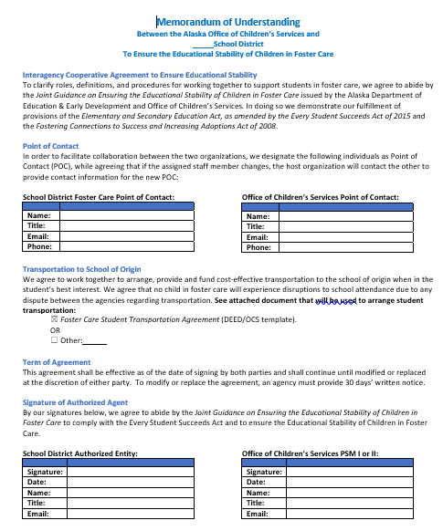
1. Establish POCs and Transportation Agreement for District and OCS
Points of Contact:
  For Office of Children’s Services (OCS)
    Local Case Worker/Protective Services Specialist (PSS)
    Regional Protective Services Manager (PSM)
  For School District
    Federal Programs Manager
    Counselor
    Registrar
Transportation Agreement:
  All districts accepting Title I-A funds must also collaborate with OCS to create a written transportation agreement to ensure FC student will be provided daily transportation that will enable them to attend their school of origin
    Who arranges, who provides, who funds
    Dispute Resolution Policy

Slide 8
Points of Contact (POC)
Who is our district FC POC?
  Contact Information:
Who is the OCS POC for our district?
  Contact Information:

Slide 9
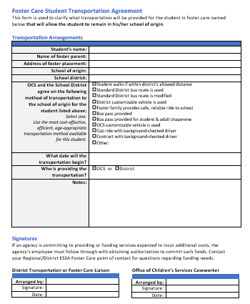
Transportation Agreement for Rural Roadless Districts
Consider using DEED/OCS Template to establish required Transportation Agreement
  Few students per year needing transportation
  Complete for individual students on case-by-case basis
  Lists transportation options
  No prior promise of OCS funds
Even for foster students remaining in a community with only one school option, that school option is still considered the “school of origin”
Even within a village where everyone typically walks, if walking to the school of origin is a barrier to attendance for a child in foster care, transportation should be provided
If student’s foster care placement is in a different school community not connected by road, no transportation is required; student transfers schools

Slide 10
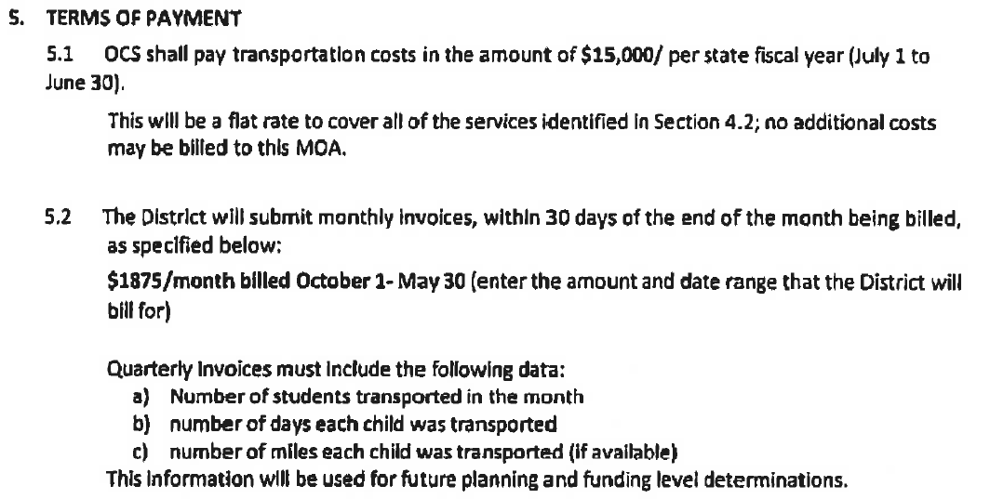
Transportation Agreement for Large Urban Districts
Consider establishing a contract with OCS/DFCS
  Frequent and daily FC transportation
  12-month commitment
  Specific funding promised by OCS
  Specific services (and funding) promised by district
  Can include staff time as expense
  OCS Contacts for contracts:
    Richard Bloomquist, OCS Program Coordinator
Transportation to school of origin even applies to student whose foster care home is in a neighboring district, if less than 50 miles away.
Transportation method should be the most safe and cost-effective option

Slide 11
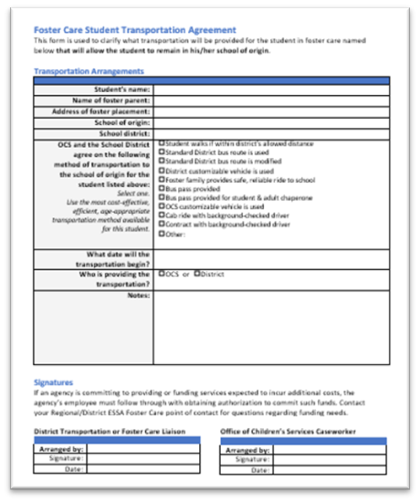
Transportation Agreement for Rural Districts with Distant School Communities Connected by Roads
Consider using DEED/OCS Template to establish required Transportation Agreement
  Few students per year needing transportation
  Possibility of lengthy transportation needed with little transportation infrastructure
  Complete for individual students on case-by-case basis
  Lists transportation options
  However, no prior promise of OCS funds
Consider requesting a simple custom agreement with OCS that says district will spend up to $1500 per year on FC transportation; if costs exceed this, OCS will reimburse for the subsequent $1,500
Transportation to school of origin even applies to student whose foster care home is in a neighboring district, if less than 50 miles away.

Slide 12
Transportation Agreement
What type of transportation agreement has our district established with OCS?
What are the typical methods of transportation for students in foster care that our district uses?

Slide 13
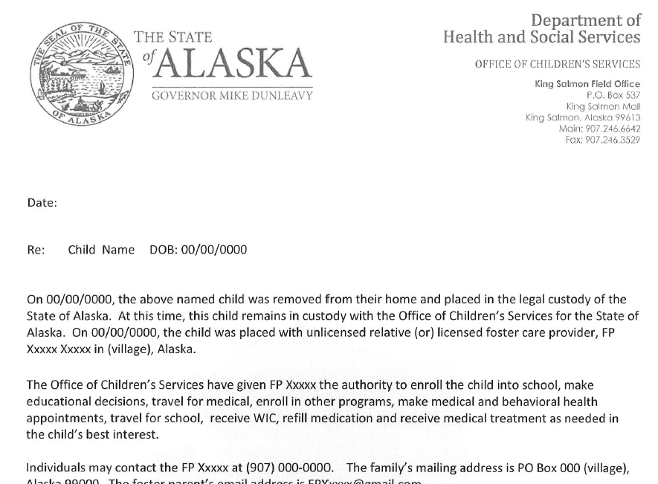
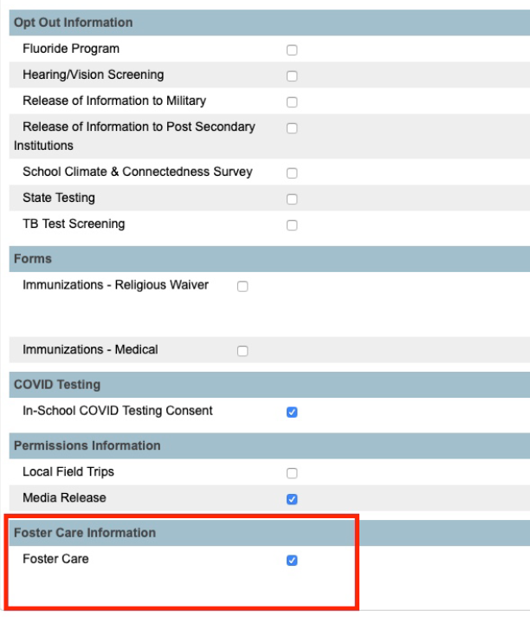
2. Receive and Record Student’s FC Status
Establish protocols with OCS
Train staff, particularly school receptionists and registrar
Require OCS document indicating custody
Record status (securely)
    Student Information System
Update address/guardian information
Inform staff who “need to know”
    Counselor
    Main Teacher
    Bus Service
    Student Nutrition
    Front Desk
Expect “parallel program” or “false” identification

Slide 14
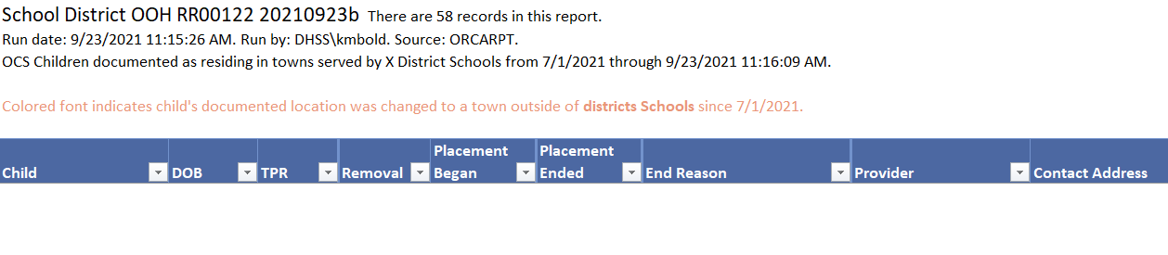
Resource: Weekly Report from OCS/DFCS
District should request to receive weekly OOH Report from OCS/DFCS.
  Lists all FC students in Out-of-Home placements in your district’s communities
  Includes transition dates, name of foster parent, case worker and contact info, parental restrictions, and more
  Instructions on DEED Foster Care page , “Receiving Student FC Status from OCS” tab

Slide 15
Receive and Record Student’s FC Status
About how many students in our district are in foster care over the course of a typical year?
How does our district typically learn a child has been newly taken into foster care or has had a change in their foster are status?
What should school staff do when someone contacts a school indicating a child is in foster care?
What sorts of formal documentation of foster care status and custody should be obtained?
Does the district receive the weekly OOH Report? If so, which staff receives it?
In the district electronic student information system, how does staff mark that a child is in foster care?
How can staff see a child’s foster care status in the student information system? How can they query to get a list of all students currently in foster care?
How will staff that “need to know” a student is in foster care be notified?
Who are the staff in our district that “need to know”?
When the district receives information that a child is no longer in foster care, what formal documentation is required? Who updates the child’s foster care status in the student information system? How?

Slide 16


3. Allow to Remain in “School of Origin”
Student is allowed to remain in the school they were attending (or would have attended) immediately prior to being placed in foster care for the remainder of the time they are in foster care.
The school the student was attending (or would have attended) immediately prior to being placed in foster care is called their “School of Origin” or SOO
It is always assumed that remaining in the School of Origin is in the student’s best interest; however--if it is formally determined to be in the student’s best interest to change schools, that new school will be considered their “School of Origin” if yet another change in home placement were to subsequently occur
DEED/OCS always consider it to be in the student’s best interest to change schools if their FC placement is in a school community more than 50 miles from their original school or if it’s not connected by road

Slide 17
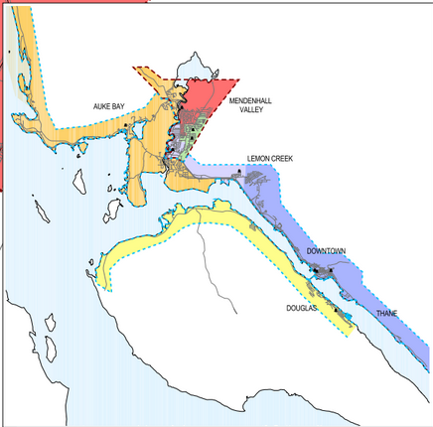
With and Without Educational Stability
Home of Foster Child (with 2 placement changes in less than one year) | School of Foster Child without educational stability requirements | School of Foster Child with educational stability requirements
Birth Family | Downtown Elem | Downtown Elem
Foster Family #1 | Douglas Elem | Downtown Elem
Foster Family #2 | Mendenhall Valley Elem | Downtown Elem
Birth Family | Downtown Elem | Downtown Elem
 | 3 school changes | 0 school changes
Notes:
Without these I-A rights, a child in FC would likely be moved to the neighborhood school of whatever FC family they are placed with.
On the left is a map of the Juneau School District’s elementary school attendance zones. There are about 6 elementary schools in JSD, and where you live determines what school you attend.
Let’s imagine a typical child in foster care who will be in Foster care less than a year and who will experience two changes in foster care family placement during that time.
So if our child’s family lives in downtown Juneau in the purple area, they will attend Downtown Elementary. But then they are placed with a foster care family in Douglas, the yellow section, and so are moved to Douglas Elementary. Yet another placement change to a home in the red area, places them in Mendenhall Valley Elementary. Before the school year ends, the student is reunited with their mom in the purple downtown area and once again enrolls in Downtown Elementary. Without the protections of Educational Stability the child has transferred schools 3 times.
The chart on the right attempts to illustrate what might happen to the typical child in FC. The middle column shows what typically happens without the right to educational stability—namely, the student switches schools 3 times.
In contrast, the final column shows what ideally happens with the ESSA right to educational stability: Regardless of the home placement changes in the first column,--from purple to yellow to red to purple--the foster child remains in the same school—the purple Downtown Elementary school--their school of origin--the entire time.
As you likely realize, the key and the challenge to this child remaining in Downtown Elementary is transportation.

Slide 18
Notes for Rural Schools
For many rural schools, maintaining “School of Origin” is either easy or impossible:
  In a rural village with only one school and without any roads to another school community—
    If the child’s foster care placement is in their original home community, their School of Origin is the only school option (easy)
    If the child is moved to another community, it is not feasible to transport back to SOO every day, so they must switch schools (impossible)

Slide 19
Allow to Remain in “School of Origin”
What should staff say and who can they contact if a foster parent or case worker is trying to enroll a foster student in a new school instead of keeping them in their School of Origin which is connected by road and less than 50 miles from their foster care placement/home?

Slide 20
4. Provide Transportation to School of Origin
District must collaborate with OCS to provide daily transportation to enable a child in foster care to attend their School of Origin (unless the child’s foster care placement is in a new community that is not connected by road to their School of Origin or is more than 50 miles away by road)
Allowable for district to use Title I-A funds, regardless of whether student attends Title I-A school
Allowable for OCS to use Title IV-E funds
Common forms of transportation: Walk, tweak school bus route, foster parent drives, taxi, school vehicle that can run customizable route, in lieu of transportation agreement, contract with to background-checked snow machine driver
This only applies to maintaining a student in their School of Origin; if they were transferred to a new school, this requirement does not apply

Slide 21
Notes for Schools that Usually Don’t Provide Transportation
  In villages where there is only one school, and even if “everyone walks,” if that school is their “school of origin” then that FC student is entitled to transportation to school if it becomes a barrier to their attendance.
  The same applies to charter schools that provide no transportation for any of its regular students and to schools that have switched from buses to offering parents In Lieu of Transportation Agreements.
  In many communities without buses “where everybody walks,” many families actually snowmachine their children to school when winter temperatures are dangerous.
  Even if it is unlikely an FC student would need transportation, the district needs a plan/method for how it would be provided ready.
  Offering the foster parent an In Lieu of Transportation Agreement is one option but should not be the only option. The FC parent may not have the means, ability, or time to do the transportation, and it is not their obligation to do it, so the school needs other options available.

Slide 22
Provide Transportation to School of Origin
Which staff arranges the transportation necessary to keep the foster care student enrolled in their School of Origin?
  Contact Information:
What are the methods of transportation for foster care students available in our district?
What is the process for requesting unique transportation for the student in foster care?
What forms do we use to request, arrange, or provide transportation?

Slide 23
5. Determine and Document If in Student’s Best Interest to Switch Schools
Districts should only enroll FC students in a new school when it has been formally determined to be in student’s best interest to switch schools
A formal Best Interest Determination (BID)
  uses input from key stakeholders such as caseworker, school staff, foster parent, district POC, Guardian ad Litem, student, and parent;
  consults via meetings, phone calls, and/or email; and
  is documented in writing.
Districts may always assume it to be in the student’s best interest to switch schools if their FC placement is in a new community more than 50 miles from their School of Origin or if it’s not connected by road

Slide 24
Determine and Document If in Student’s Best Interest to Switch Schools
In our district, about what percentage of the time is it obviously in a foster child’s best interest to switch schools because their foster care placement/residence is in a new community more than 50 miles from their School of Origin or if it’s not connected by road?
About how many Best Interest Determination (BID) events are held in our district over the course of a typical year?
Which staff in our district typically arrange Best Interest Determination events?
  Contact Information:
Which staff in our district typically participate in BIDS?
Who else typically participates in our BIDS?
How are BIDS typically conducted in our district?
What type of “evidence” is usually used in a BID in our district?
What forms does our district use to document BIDS?
Where is the BID saved?

Slide 25

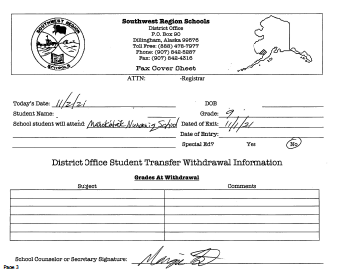
6. Expedite Enrollment If in Student’s Best Interest to Switch Schools
If formally determined in student’s best interest to change schools-- Expedite enrollment in new school
If receiving:
  Allow to enroll even if normally required records are unavailable
  Work with prior district, health clinic to track down records
If transferring:
  Send records immediately to new school

Slide 26
Expedite Enrollment If in Student’s Best Interest to Switch Schools
Which staff requests the educational records from the previous school?
  Contact Information:
What process and forms are used to get educational record?s
Which staff tracks down health records?
  Contact Information:
What process and tools or forms are used to get health records?
How do we make a schedule for HS or MS student before receiving transcripts?
How do we provide most appropriate services for student with disabilities before IEP is received?
Who updates the child’s foster care status and /or school in the student information system?

Slide 27
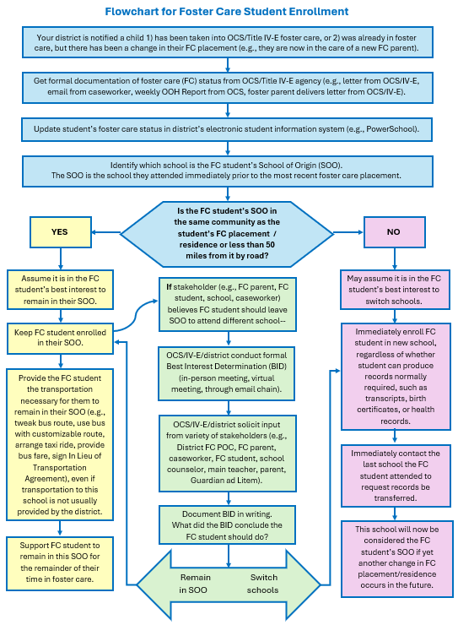
Flowchart for FC Student Enrollment
This flowchart summarizes elements
2 – 6
of this slideshow.
A copy can be found on the DEED Foster Care website.

Slide 28
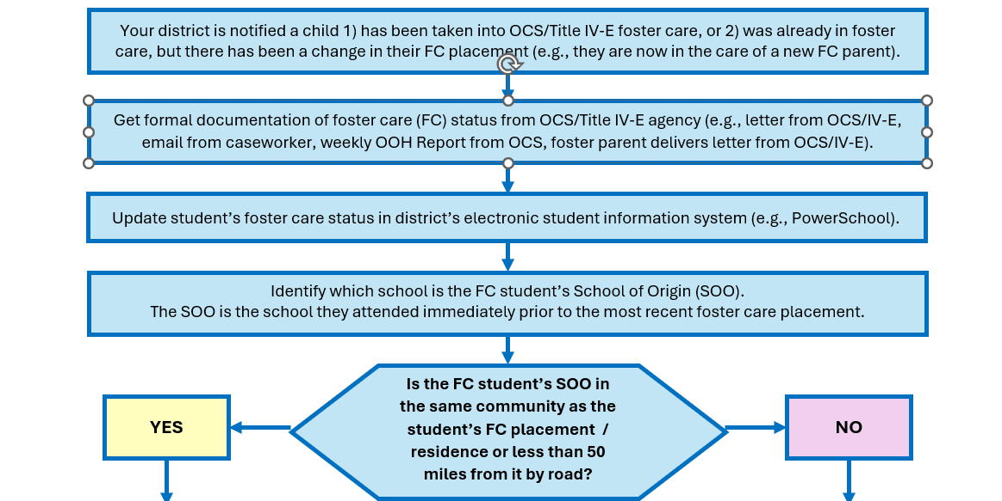
Flowchart for FC Student Enrollment

Slide 29
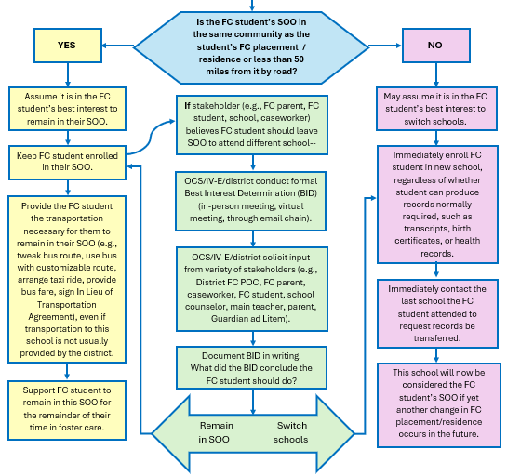
Flowchart for FC Student Enrollment

Slide 30
Additional Rights of Students in Foster Care
Students in foster care are considered “categorically eligible” for free meals under the programs of USDA during the time they are in foster care.
In addition to receiving free meals the schools serves, the student in foster care should be considered “economically disadvantaged” in district reporting, regardless of the economic status of the foster family.

Slide 31
Annual Foster Care Questions in GMS
D.8: MOU with OCS and other Title IV-E Agencies
  Attach current, signed MOU with OCS/Title IV-E agencies that includes POC information and (if accepting Title I-A funds) a transportation agreement
D.9: Tracking students in FC
  Describe how district and school learn student FC status, where FC status is recorded
D.10: Transportation for students in FC
  Describe district geography and transportation options
D.11: Expedited enrollment for students in FC
  Describe district enrollment and records transfer processes

Slide 32
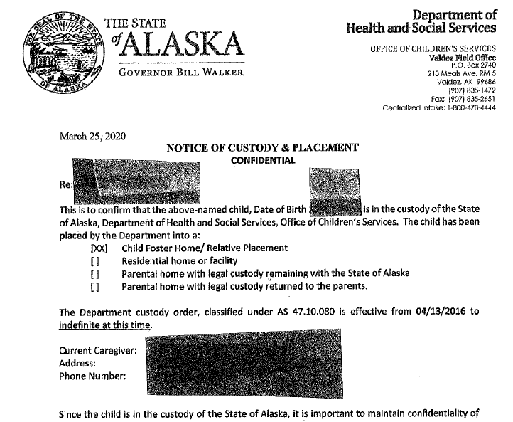

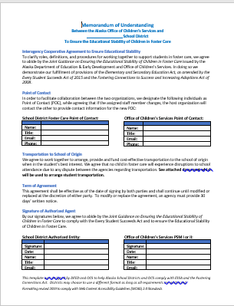
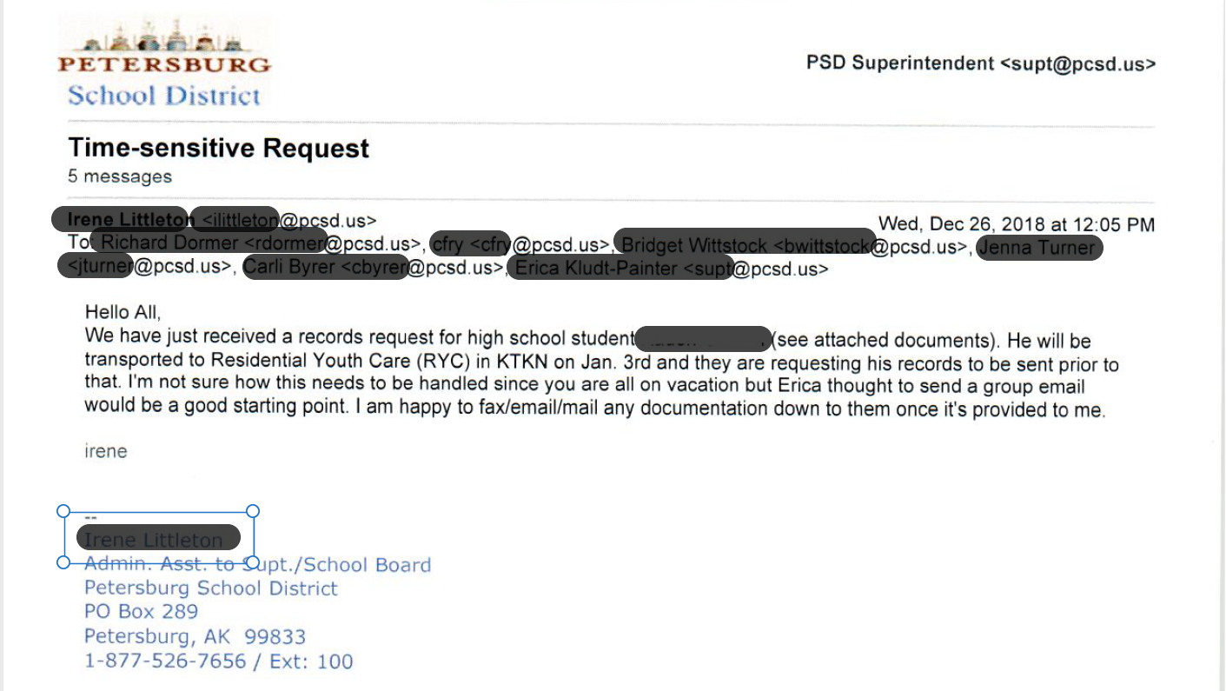
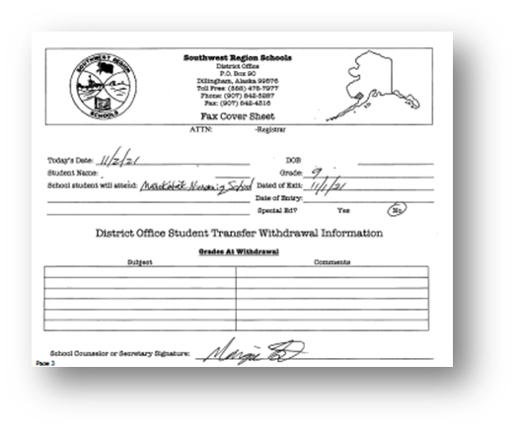
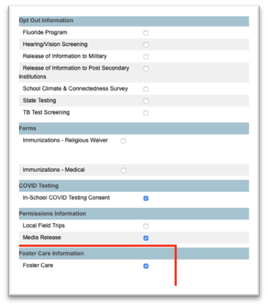
Compliance Monitoring
Evidence/Documentation of Implementation:
  (Current MOU and Transportation Agreement)
  Notification from OCS of individual FC student status, such as formal letters and weekly OOH Report
  School database of students in Foster Care
  Transportation request, receipt, bus route map
  Best interest determination meeting/decision notes, invites, emails
  Email from registrar showing expedited records request; email tracking down immunization records instead of barring entry;
  Written district protocols and training for staff regarding FC data, maintenance of School of Origin, transportation, and enrollment for FC students.

Slide 33





Resources: DEED Foster Care Webpage
Guidance and Templates and Training Documents
  Joint Guidance clarifying definitions, expectations, some protocols
  MOU template
  Transportation Agreement template
  BID Form and Tracking Sheet
  Flowchart for Foster Care Enrollment
  Training slides
Connecting with OCS
  Map and list of OCS regions and offices
  Email addresses for OCS regional PSMs
Receiving Student FC Status from OCS
  Weekly OOH Report Sign Up instructions
Federal Statutes and Guidance
National Resources

Slide 34

Contact Information
Jessica Paris, Program Manager
Foster Care Liaison for DEED
Jessica.paris@alaska.gov
(907) 465-8716

